Slide 1
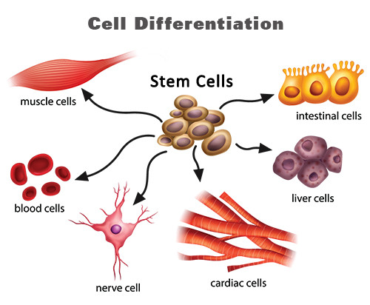
CELL DIFFERENTIATION
Differentiation is the process by which an unspecialised cell becomes specialized (i.e., it acquires a particular set of morphological and functional characteristics) in order to fulfil a particular physiological role in an organism.
Notes:
During human development, a single cell (a fertilized egg) differentiates into every different kind of specialized cell type found in the body, including blood, muscle, and nerve cells.

Slide 2
IMPORTANCE OF CELL DIFFERENTIATION
Differentiation is considered central to embryological development.
Is an essential part of life-long physiological processes that involve cell renewal, for example, the routine replenishment of the different types of cell found within the blood system.
It is also considered to form a central element of the organism’s response to injury, in the course of various healing and regenerative processes.
Notes:
Received biological understanding proposes that in higher organisms all cells come into existence unspecialised, and that in order to fulfil a particular physiological role, each cell undergoes a process during which it acquires a particular set of morphological and functional characteristics.

Slide 3
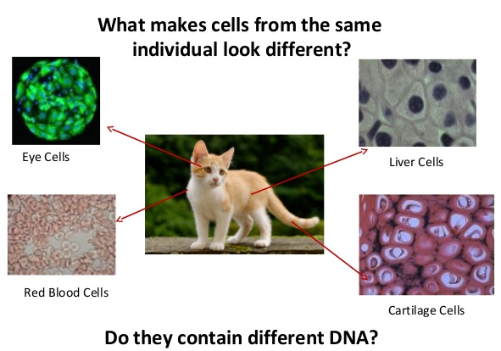
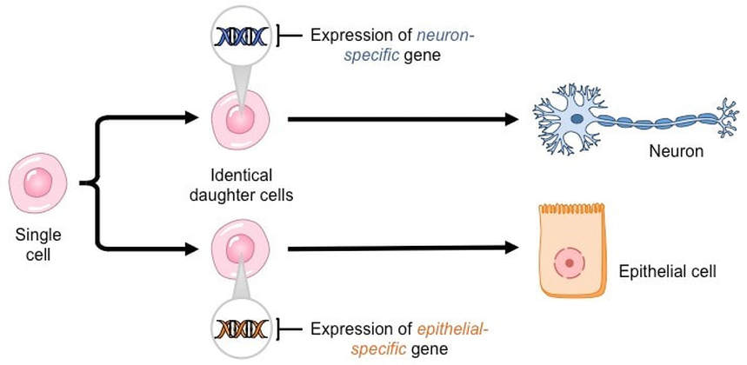
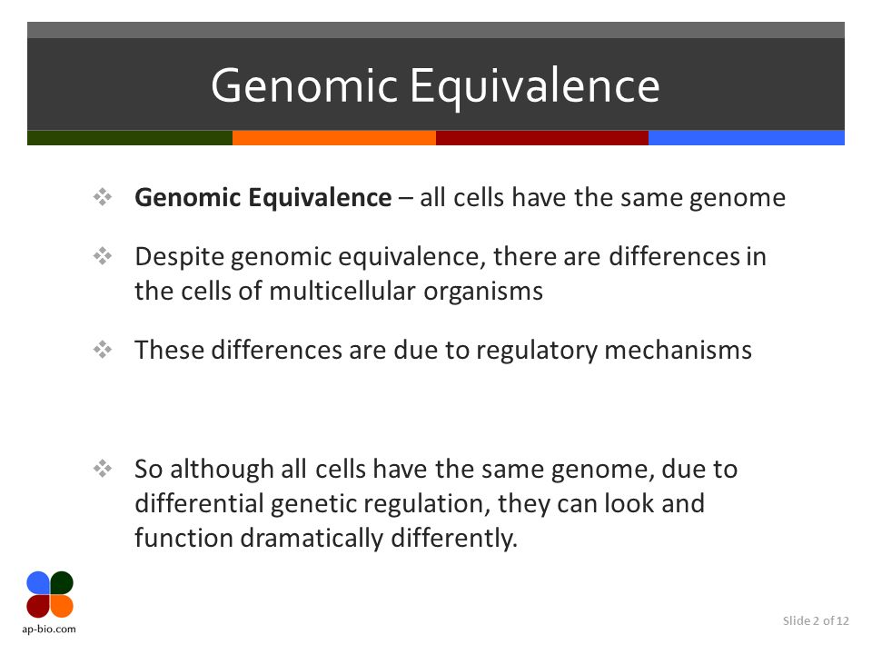
ESSENCE OF CELL DIFFERENTIATION
This is because of selective expression of the genome in time and space or differential gene expression.
The expression of different genes is turned on or off, and finally, the iconic protein is produced.
Notes:
The DNA in all the cells will be identical. However, different regions of a chromosome (DNA is wound in to a chromosome) code for different functions and cell type. Here, it's only the regions that are required to perform a given function that are expressed in each cell.
The regions (genes) that are expressed determine the type of cell that will be created. While the different types of cells that are formed contain the same DNA, it is the expression of different genes that results in different types of cells. This is to say that not all genes are expressed during differentiation.

Slide 4
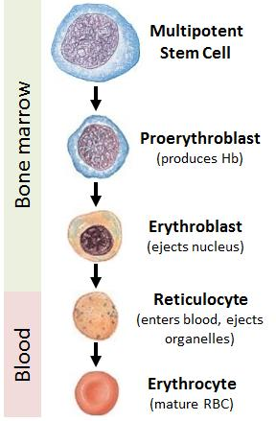
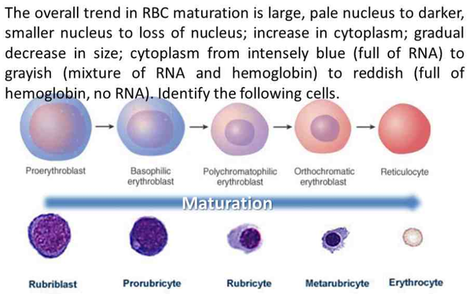
CHANGES IN GENOME DURING CELL DIFFERENTIATION
In general, the process of cell differentiation is irreversible.
However, under certain conditions, the differentiated cells are also unstable, and their gene expression patterns can also undergo reversible changes and return to their undifferentiated state. This process is called dedifferentiation (normally occurs during regeneration processes and during metaplasia).
RBC Cell differentiation - an irreversible change
RBC Cell differentiation
Notes:
Metaplasia = Metaplasia is the conversion from one type of normal adult cell to another type of normal adult cell.

Slide 5
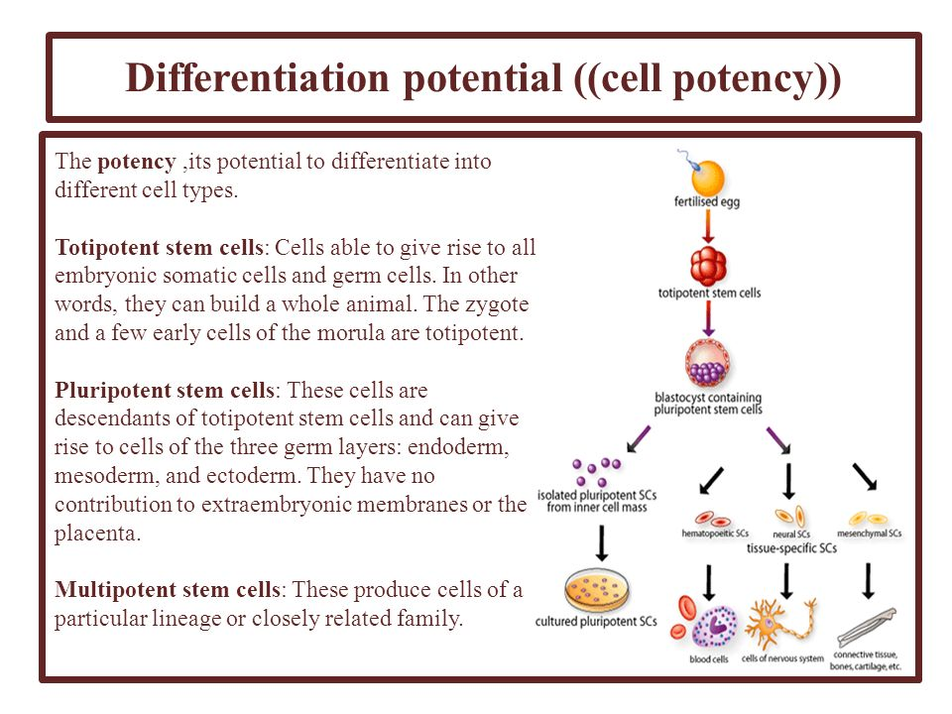
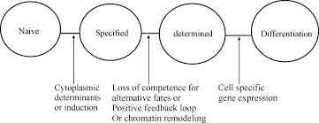
CELL POTENCY
The state of commitment may be described as "specification" representing a reversible type of commitment or "determination" representing irreversible commitment.
or unspecialised
During the differentiation process, cells gradually become committed towards developing into a given cell type.

Slide 6
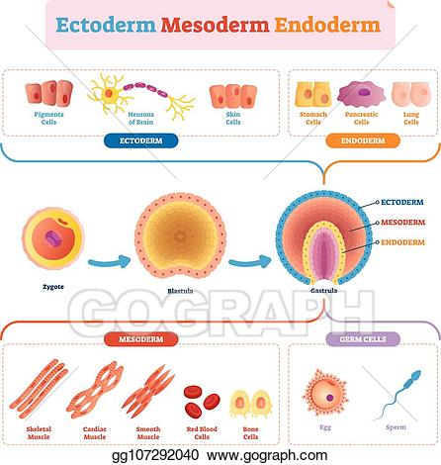
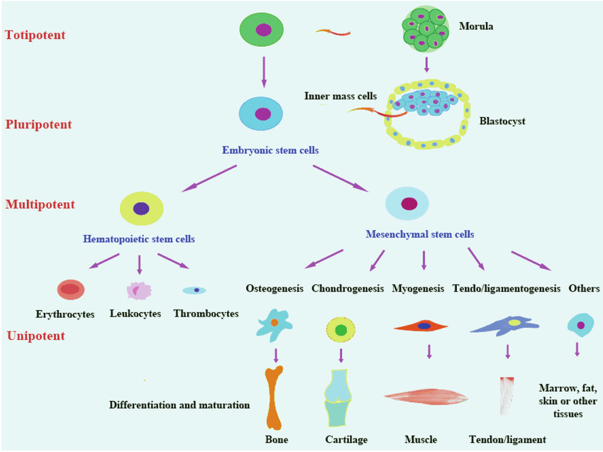
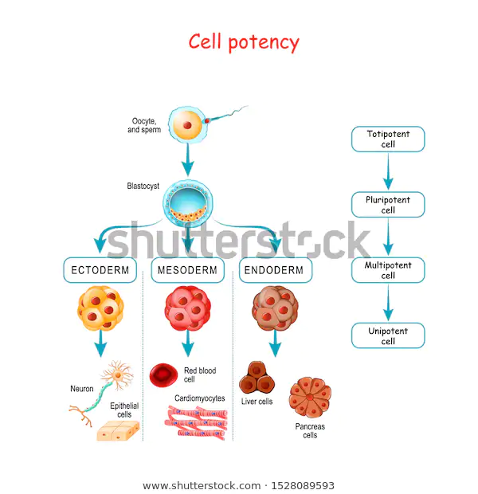
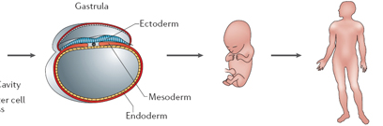
LEVELS OF CELL POTENCY
Fertilization
Egg
Sperm
Zygote
Fetus
Other committed stem cells
Adult
Blood stem cells
RBC
WBC
Platelets
Notes:
The fertilised egg or zygote has the ability to give rise to every type of cell in the adult body and hence referred as totipotent. Later in the development of animals the cellular descendants of the zygote lose their totipotency and become determinate into specific types of cells.
Cells that have the ability to differentiate into every type of cell in the body (including extraembryonic membranes like placenta) are called totipotent. Eg: zygote and first few cells that result from division of zygote.
Cells that can differentiate into most, but not all type of cells are called pluripotent.
(Or)
Cells that differentiate into all types of cells except placenta are called pluripotent. Eg: Cells present within the blastocyst (Inner cell mass).
Cells that can differentiate into a limited number of cell types are called multipotent. Eg: Blood stem cells
Cells that can differentiate into only one cell type, but have the property of self-renewal are called unipotent. Eg: muscle stem cells

Slide 7
QUESTIONS
What is cell differentiation? State its importance in a multicellular organism.
Describe the levels of potency that a zygote goes through to transform into a multicellular organism.
What is genomic equivalence? Brief how differential gene expression forms the basis of cellular differentiation.

